Slide 1
Dimensionality Reduction and Feature Construction

Slide 2
PCA is “an orthogonal linear transformation that transfers the data to a new coordinate system such that the greatest variance by any projection of the data comes to lie on the first coordinate (first principal component), the second greatest variance lies on the second coordinate (second principal component), and so on.”

Slide 3
Motivation
Clustering
One way to summarize a complex real-valued data point with a single categorical variable
Dimensionality reduction
Another way to simplify complex high-dimensional data
Summarize data with a lower dimensional real valued vector

Slide 4
Motivation
Clustering
One way to summarize a complex real-valued data point with a single categorical variable
Dimensionality reduction
Another way to simplify complex high-dimensional data
Summarize data with a lower dimentional real valued vector
Given data points in d dimensions
Convert them to data points in r<d dimensions
With minimal loss of information

Slide 5


Data Compression
Reduce data from
2D to 1D
(inches)
(cm)
Andrew Ng

Slide 6
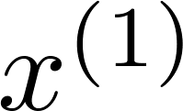
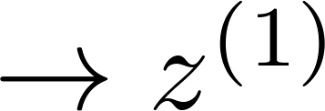
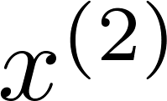
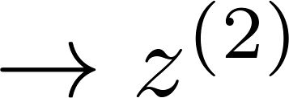
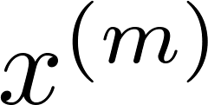
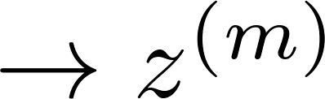

Data Compression
Reduce data from
2D to 1D
(inches)
(cm)
Andrew Ng
Notes:
Add more unique colors (3-4)

Slide 7
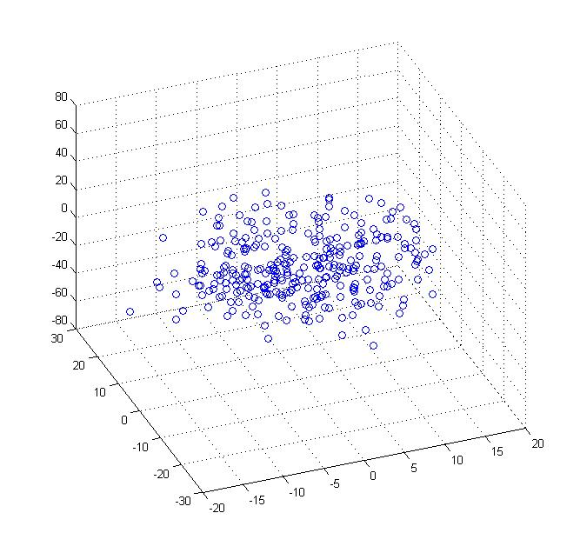
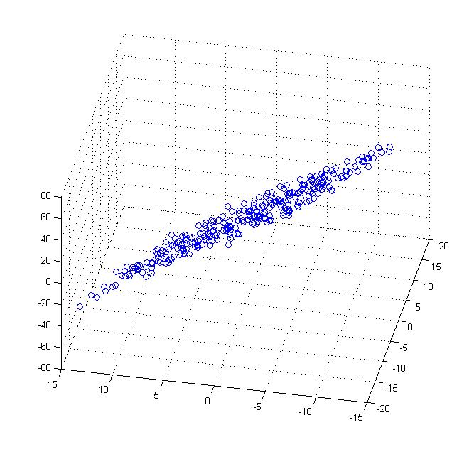
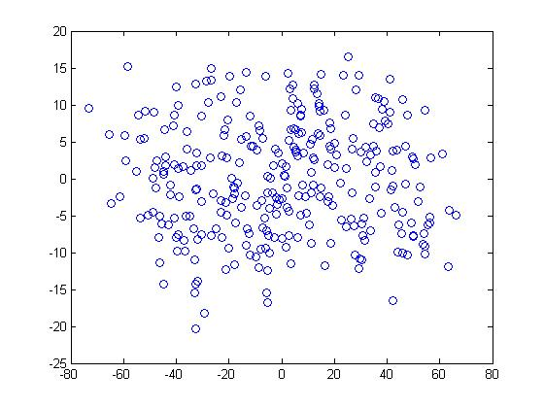


Data Compression
Reduce data from 3D to 2D
Andrew Ng
Notes:
Pca3d2d in lecture-slides/assets/pca/
Label axes

Slide 8
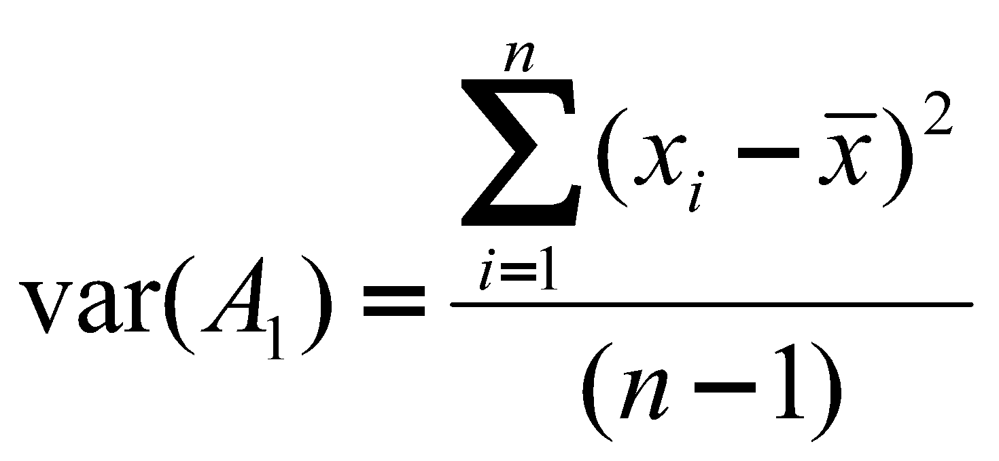
Background for PCA
Suppose attributes are A₁ and A₂, and we have n training examples. x’s denote values of A₁ and y’s denote values of A₂ over the training examples.
Variance of an attribute:

Slide 9
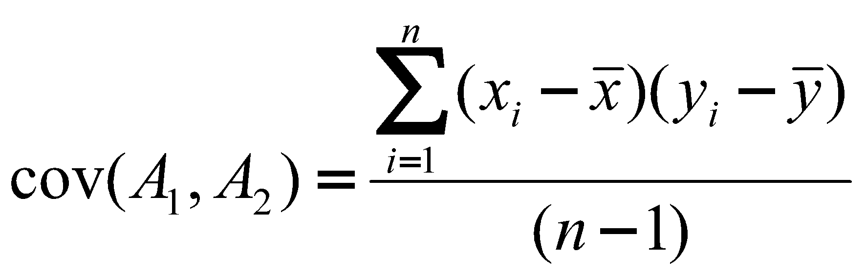
Covariance of two attributes:
If covariance is positive, both dimensions increase together. If negative, as one increases, the other decreases. Zero: independent of each other.

Slide 10
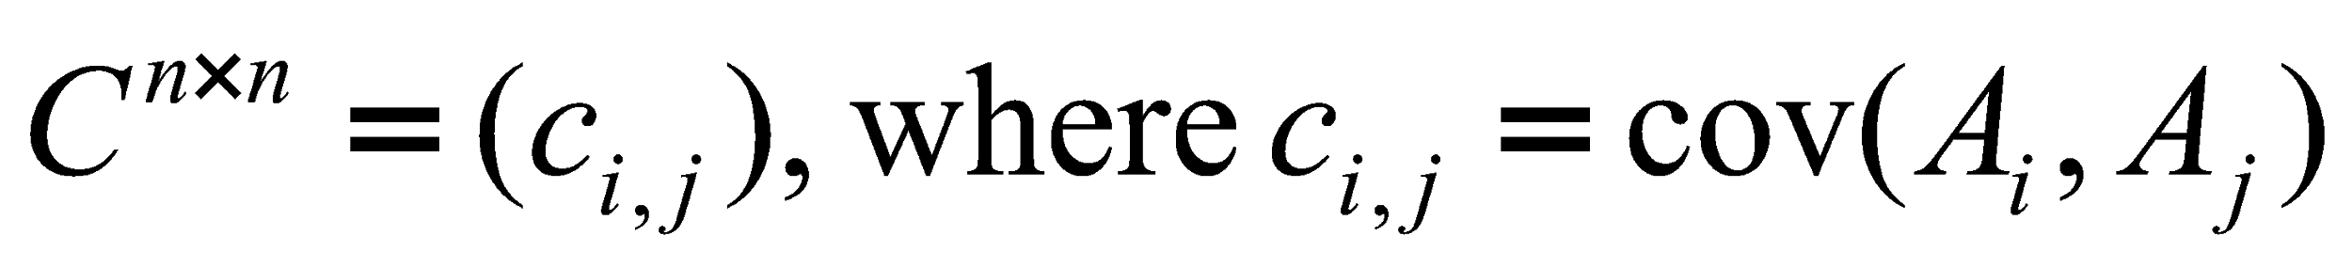
Covariance matrix
Suppose we have n attributes, A₁, ..., A_{n}.
Covariance matrix:

Slide 11
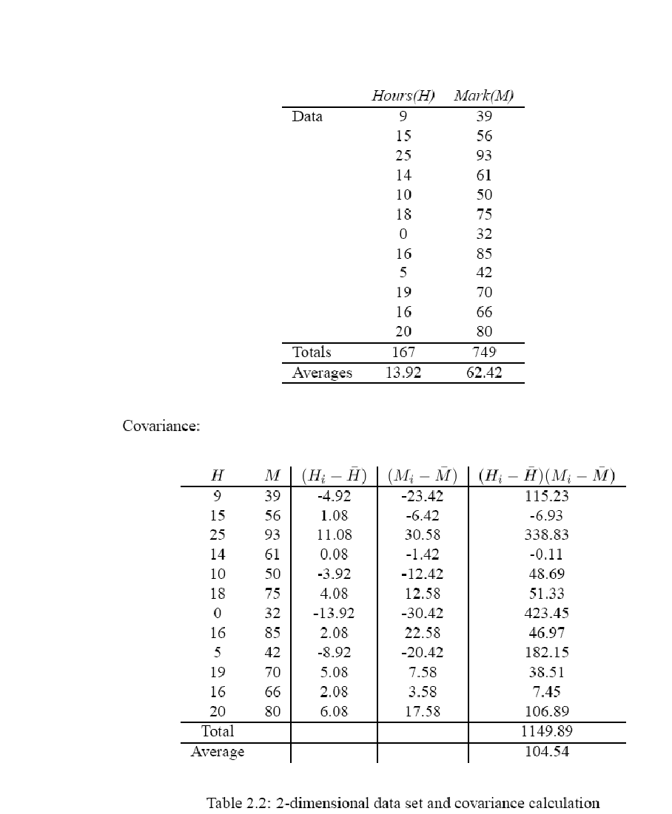
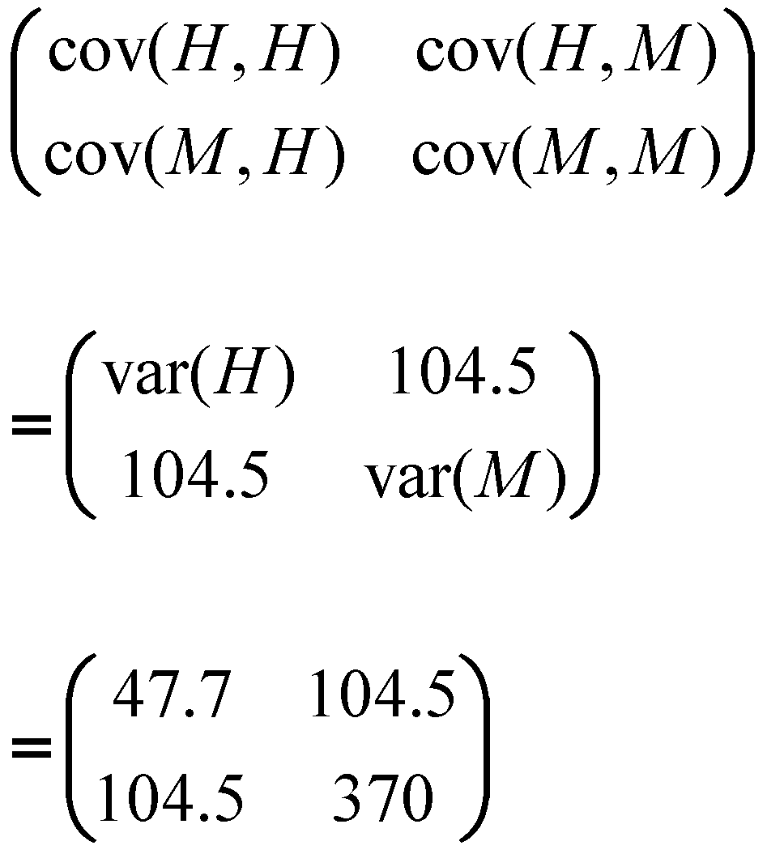
Covariance matrix

Slide 12

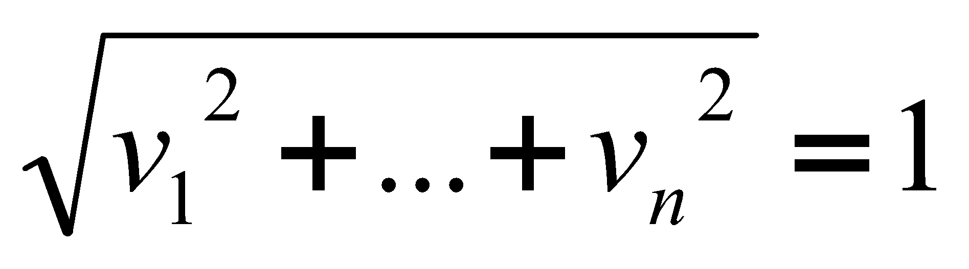
Eigenvectors:
Let M be an n×n matrix.
v is an eigenvector of M if M × v = λv
λ is called the eigenvalue associated with v
For any eigenvector v of M and scalar a,
Thus you can always choose eigenvectors of length 1:
If M has any eigenvectors, it has n of them, and they are orthogonal to one another.
Thus eigenvectors can be used as a new basis for a n-dimensional vector space.

Slide 13
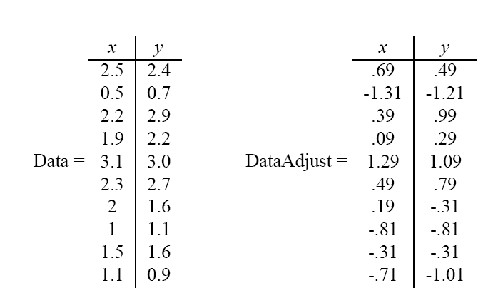
PCA
Given original data set S = {x¹, ..., x^{k}}, produce new set by subtracting the mean of attribute A_{i} from each x_{i}.
Mean: 1.81 1.91
Mean: 0 0

Slide 14
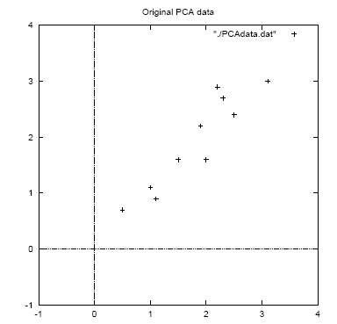

Slide 15
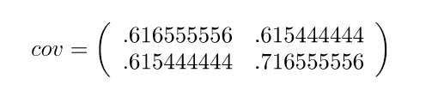
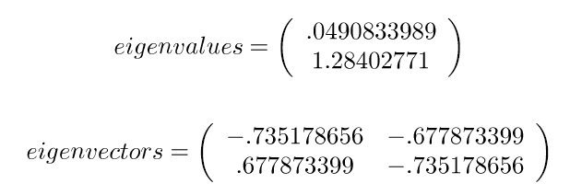
Calculate the covariance matrix:
Calculate the (unit) eigenvectors and eigenvalues of the covariance matrix:
x y
x
y

Slide 16
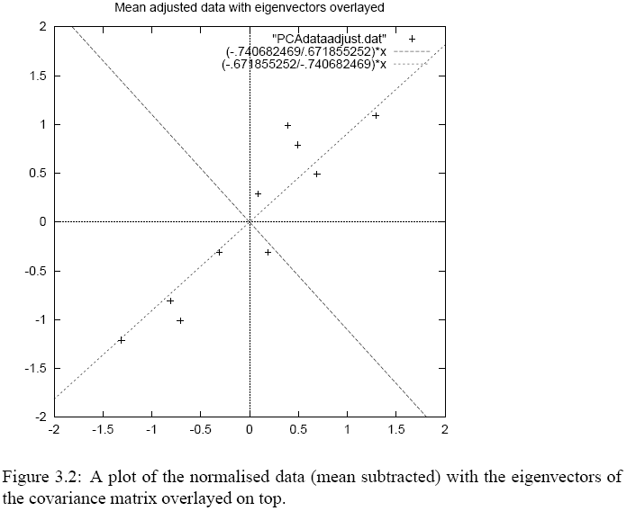
Eigenvector with largest
eigenvalue traces
linear pattern in data

Slide 17
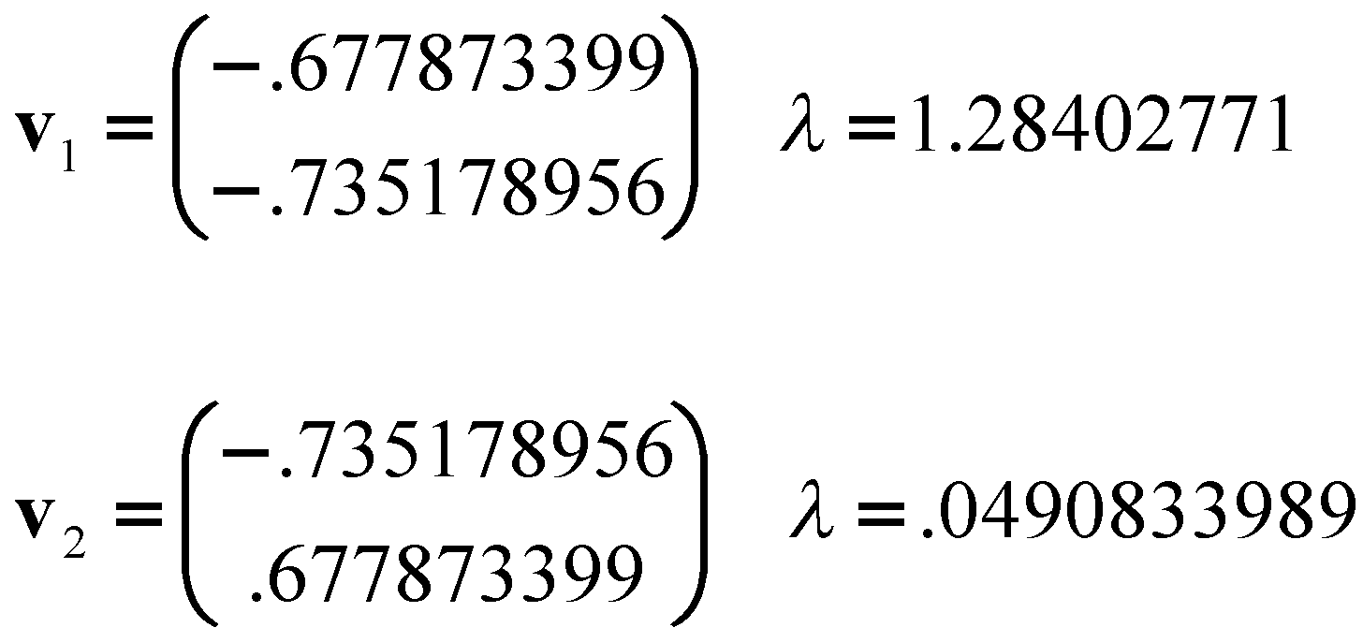
Order eigenvectors by eigenvalue, highest to lowest.
In general, you get n components. To reduce dimensionality to p, ignore n−p components at the bottom of the list.

Slide 18
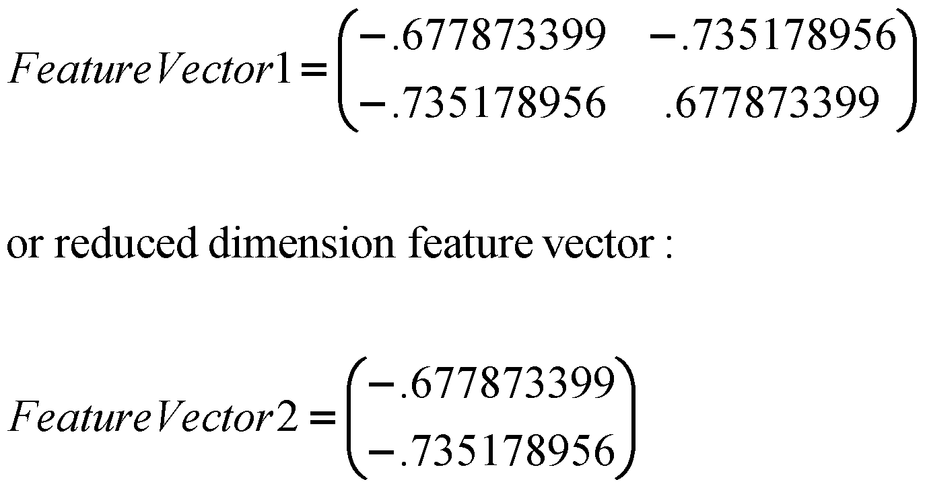
Construct new feature vector.
Feature vector = (v₁, v₂, ...v_{p})

Slide 19
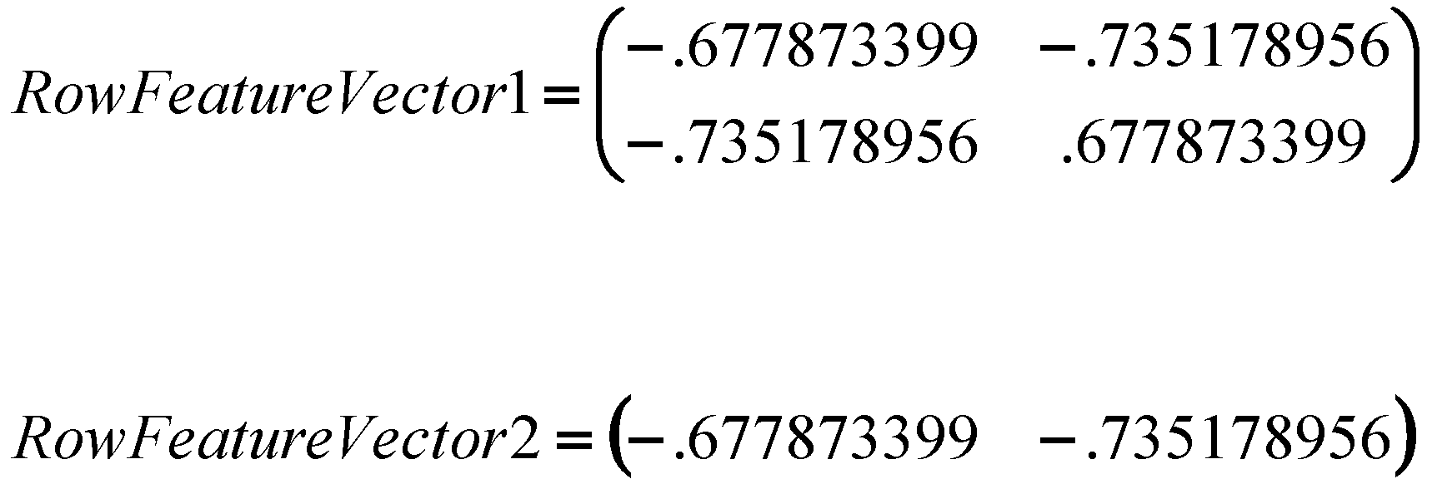
Derive the new data set.
TransformedData = RowFeatureVector × RowDataAdjust
This gives original data in terms of chosen components (eigenvectors)—that is, along these axes.

Slide 20
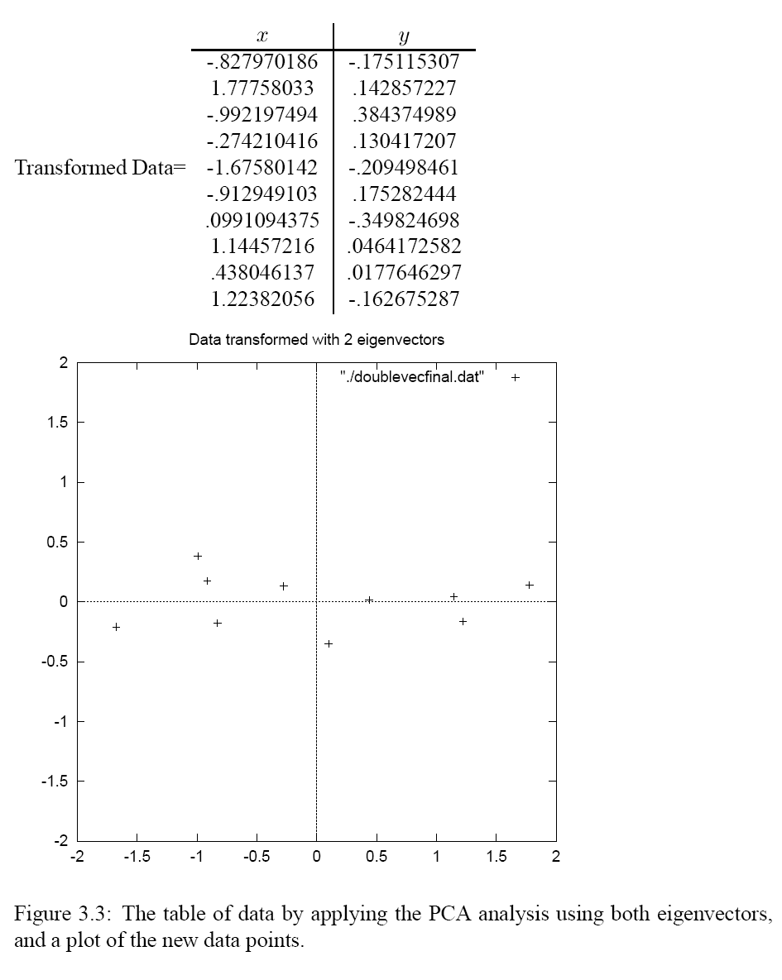

Slide 21
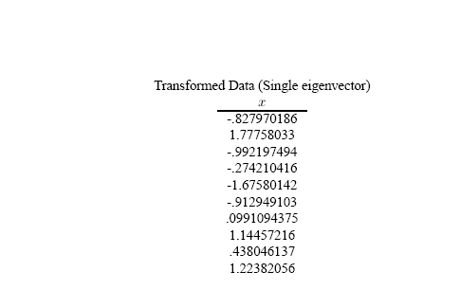
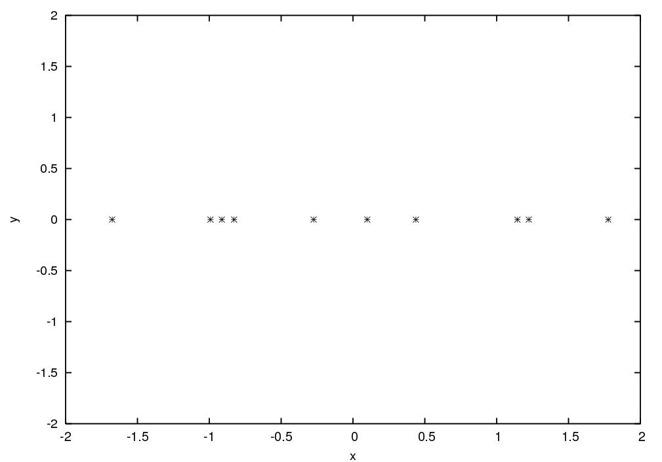

Slide 22
Reconstructing the original data
We did:
TransformedData = RowFeatureVector × RowDataAdjust
so we can do
RowDataAdjust = RowFeatureVector ⁻¹ × TransformedData
= RowFeatureVector ^{T} × TransformedData
and
RowDataOriginal = RowDataAdjust + OriginalMean

Slide 23
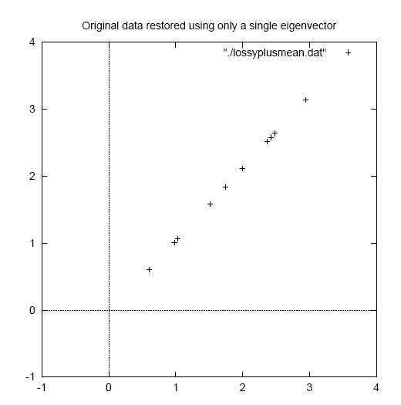

Slide 24
Example: Linear discrimination using PCA for face recognition
Preprocessing: “Normalize” faces
Make images the same size
Line up with respect to eyes
Normalize intensities

Slide 25
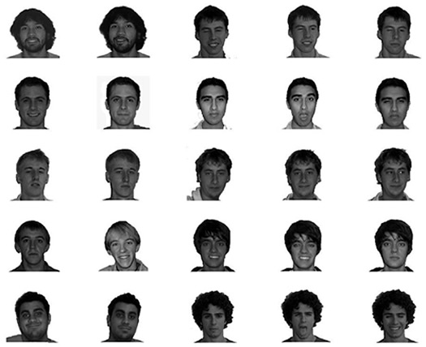

Slide 26
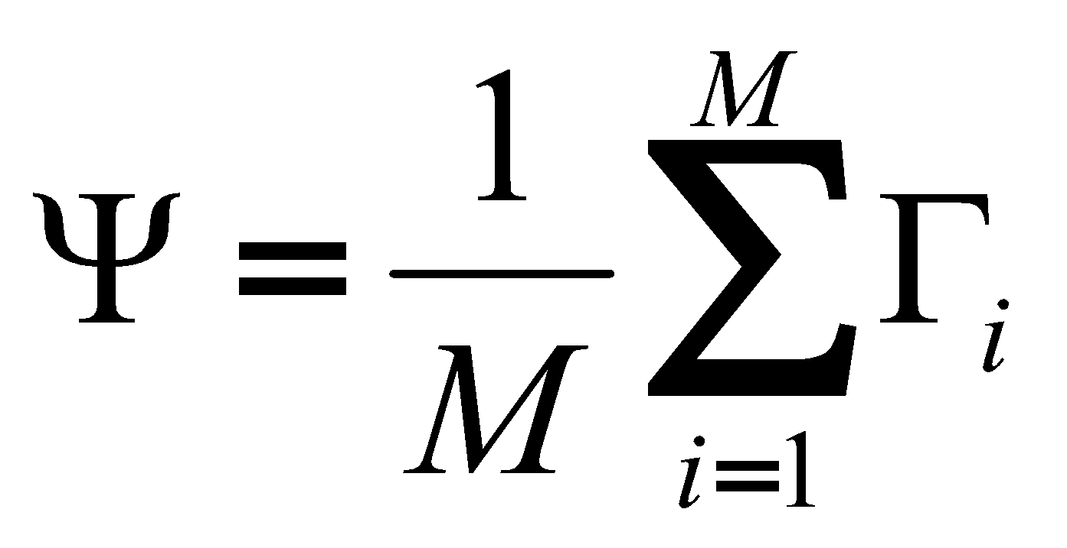
Raw features are pixel intensity values (2061 features)
Each image is encoded as a vector Γ_{i} of these features
Compute “mean” face in training set:

Slide 27
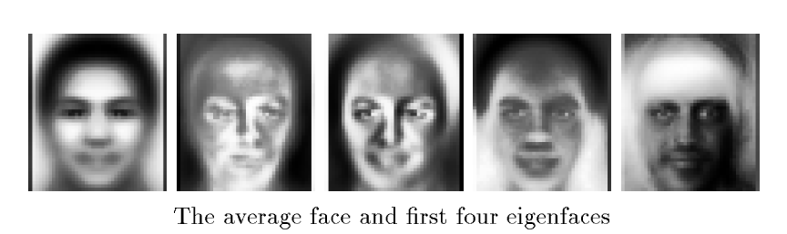
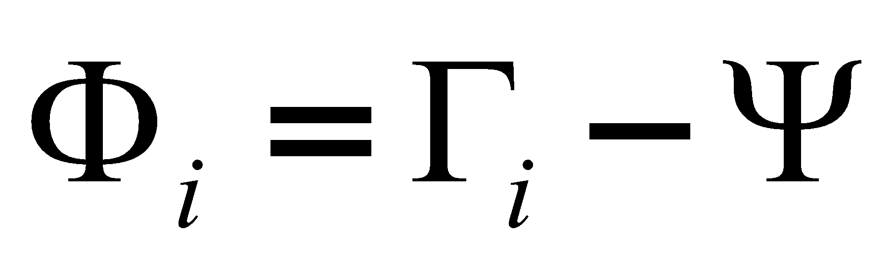
Subtract the mean face from each face vector
Compute the covariance matrix C
Compute the (unit) eigenvectors v_{i} of C
Keep only the first K principal components (eigenvectors)

Slide 28
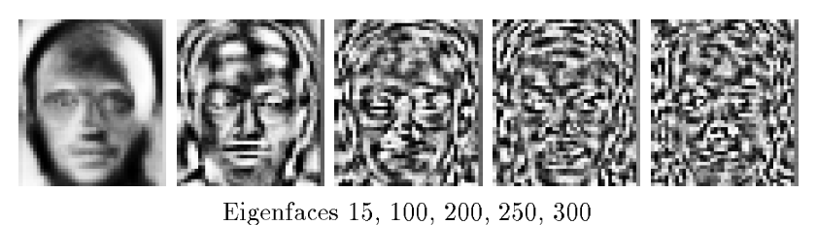
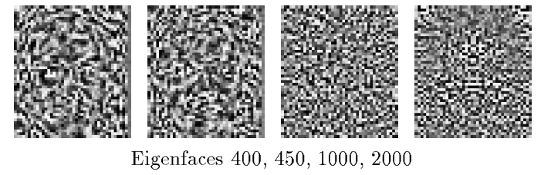

Slide 29
The eigenfaces encode the principal sources of variation
in the dataset (e.g., absence/presence of facial hair, skin tone,
glasses, etc.).
We can represent any face as a linear combination of these
“basis” faces.
Use this representation for:
Face recognition
(e.g., Euclidean distance from known faces)
Linear discrimination
(e.g., “glasses” versus “no glasses”,
or “male” versus “female”)

